Slide 1
Disk Cloning with EASEUS PARTION MARSTER Software
Disk cloning with EaseUS Partition Master helps free up space on Disk C by copying all its contents to Disk D. This process creates a duplicate of Disk C on Disk D, allowing you to remove some data from Disk C to make more room without losing any files or programs.
Presenter: WAKAABU HAMZA

Slide 2
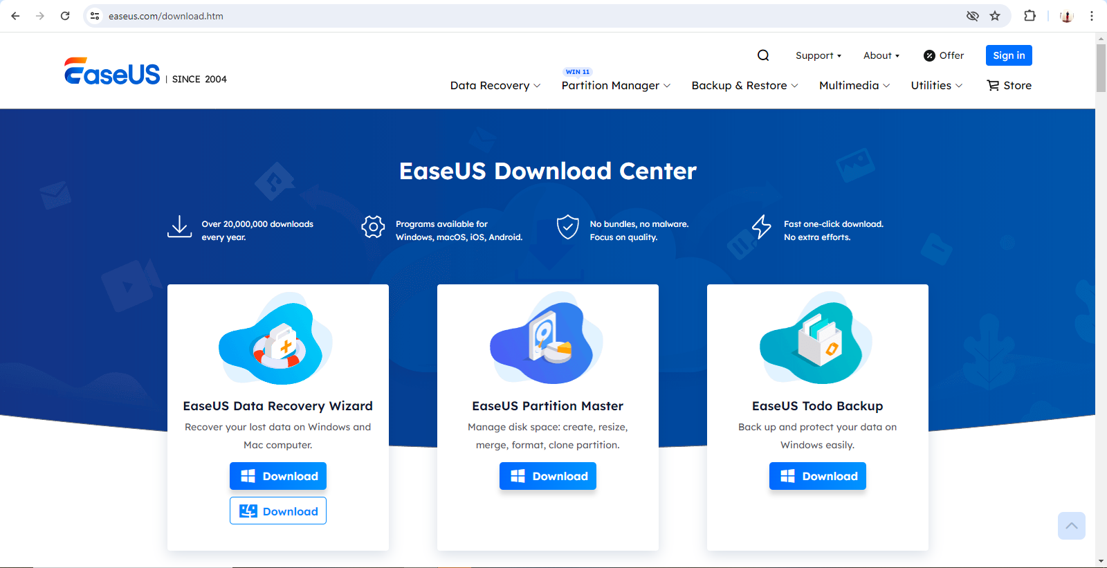
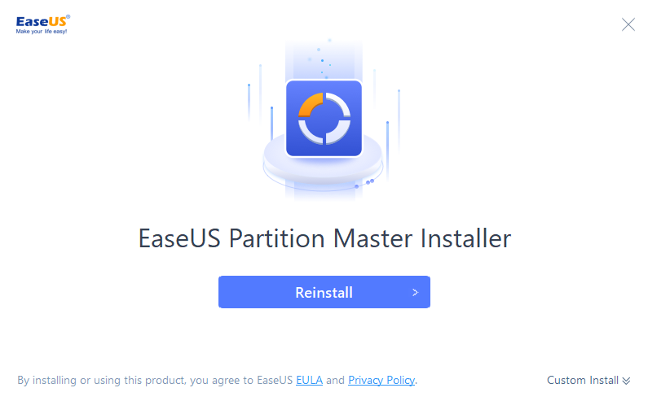
Step 1: Install EASEUS PARTION MARSTER
Navigate to Easeus website and download the Partition Assistant software.
Install the software on the system where Disk C is located.

Slide 3
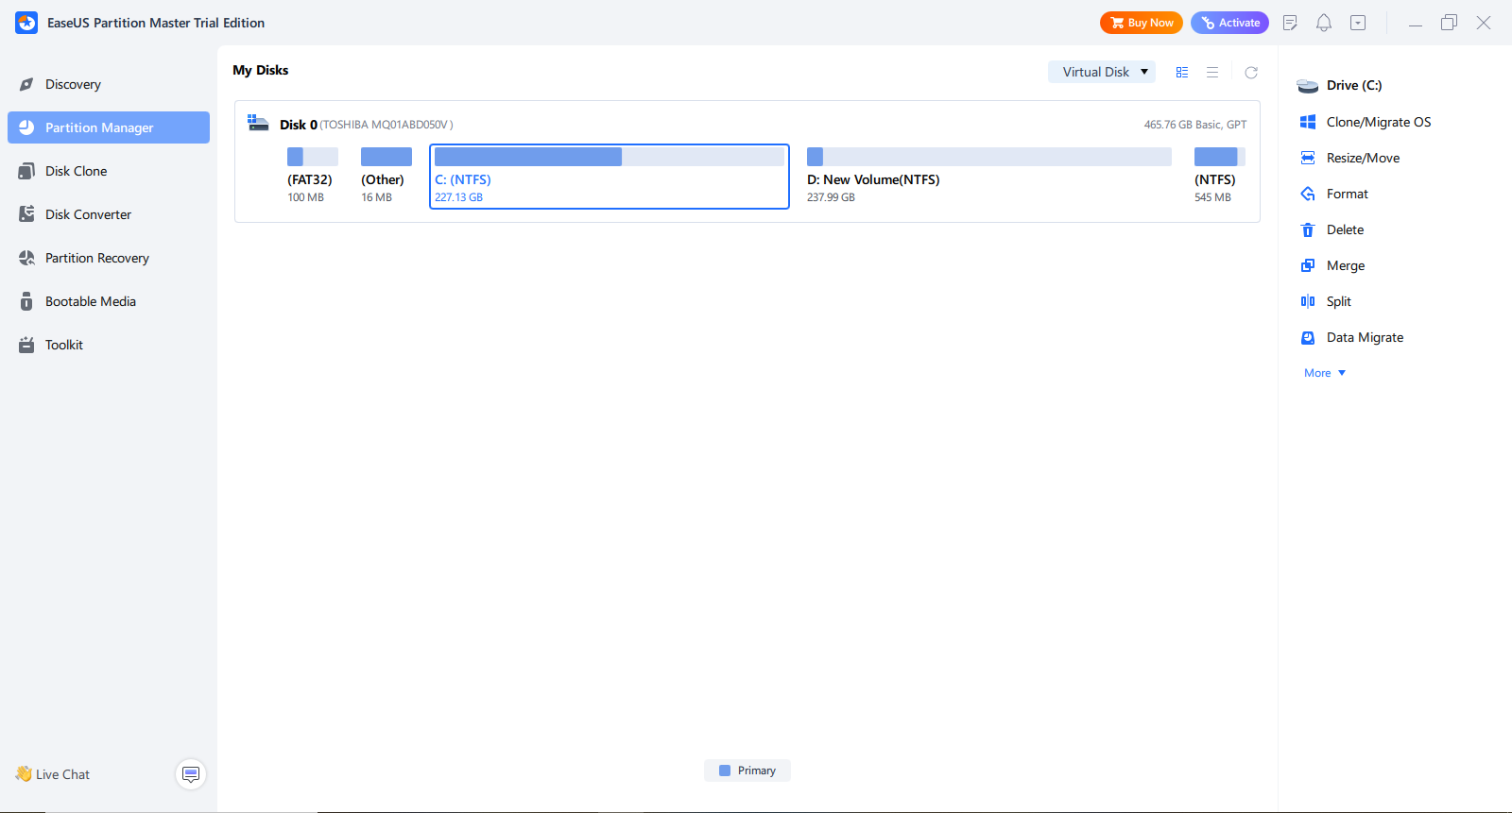
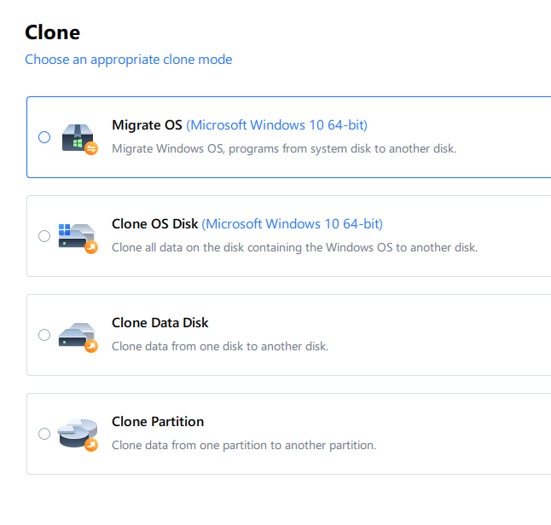
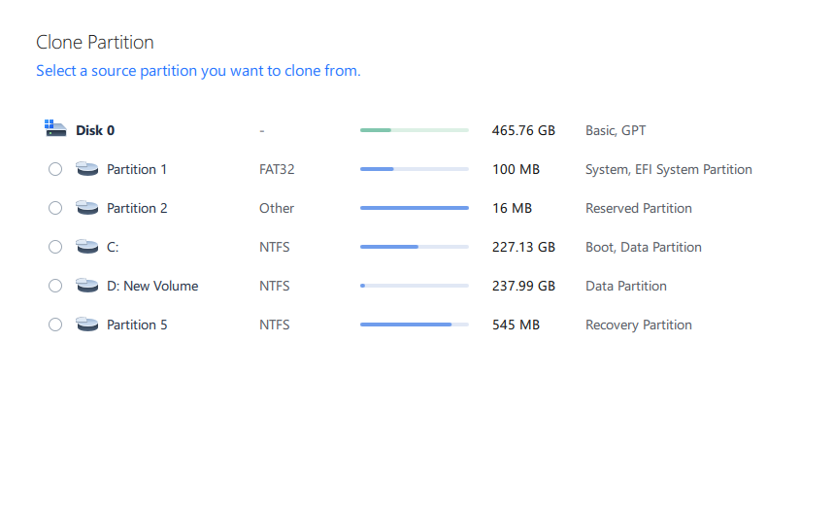
Disk Cloning Process
Step 2: Launch Easeus Partition Master
Step 3: Select Disk Clone
Choose “disk clone" for a straightforward cloning process.
Then choose clone partition

Slide 4
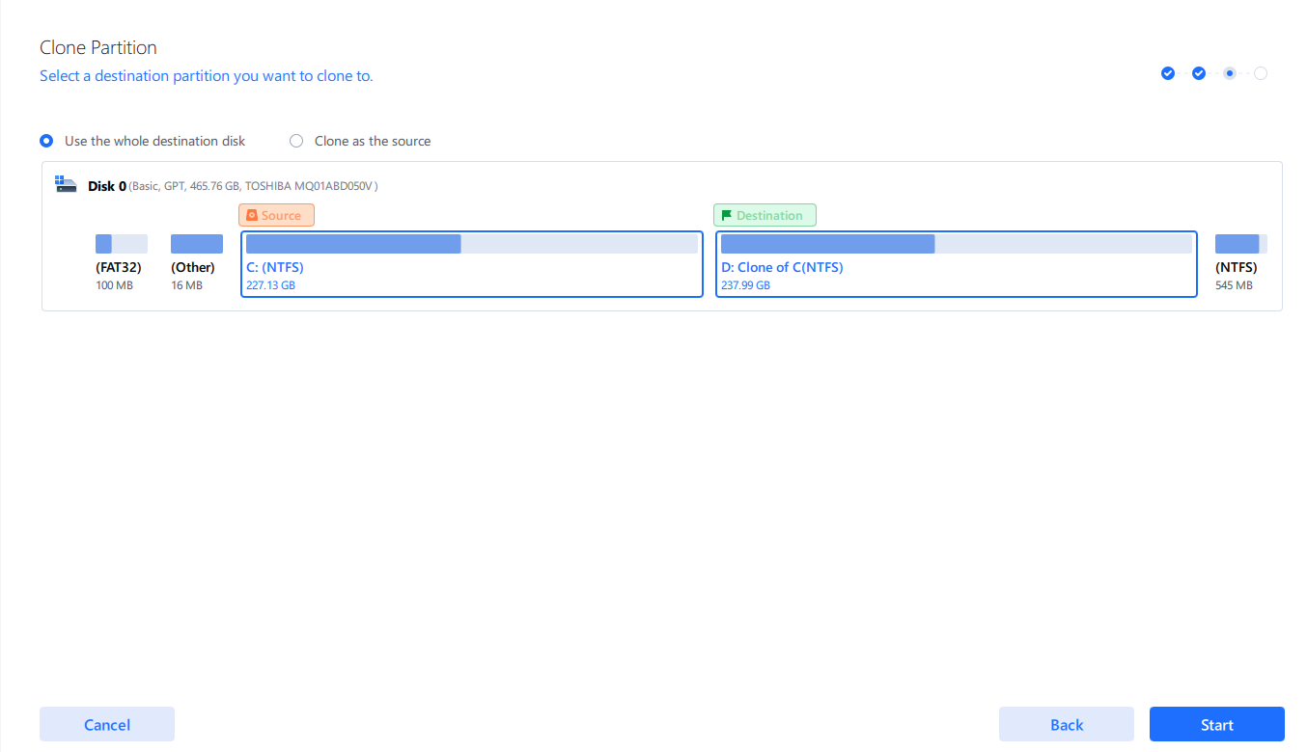
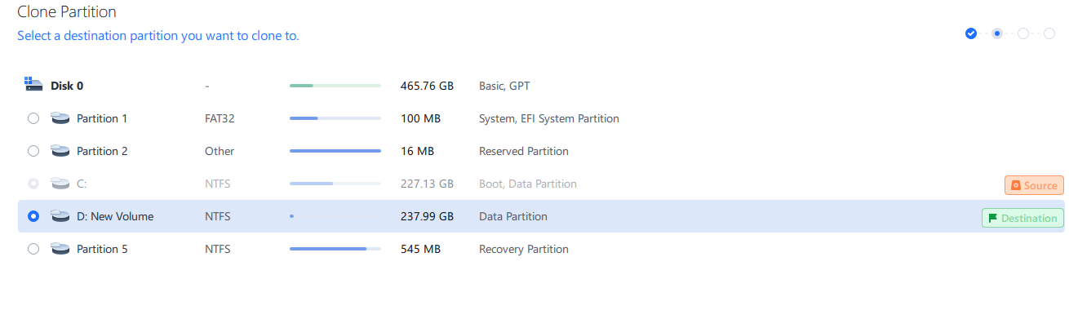
Step 4: Choose Source and Destination Disks
Select Disk C as the source disk and Disk D as the destination disk.
Review the disk layout to ensure correctness.

Slide 5
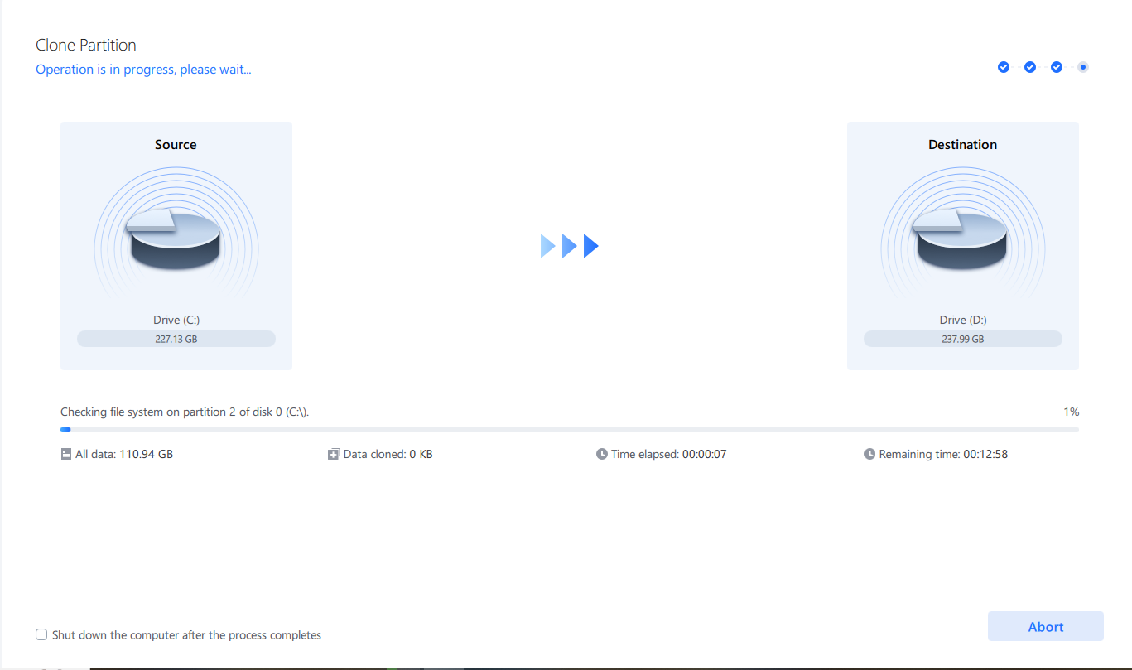
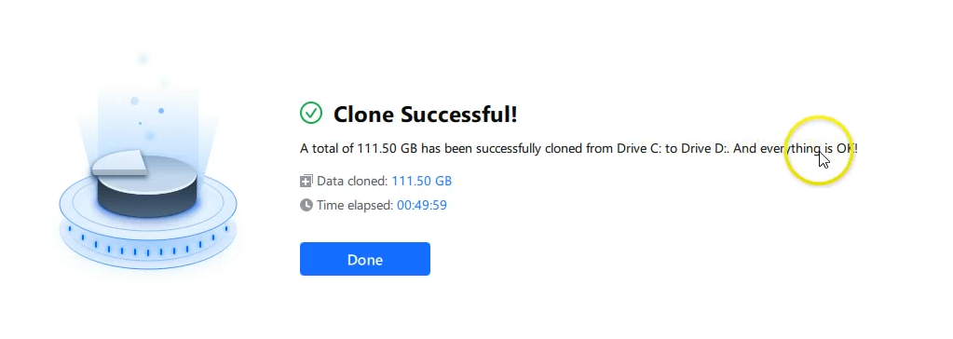
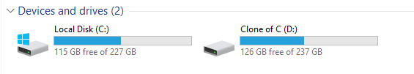
Step 5: Start Cloning
Click “start" to start the disk cloning process.
This is the view when its done cloning

